Slide 1
527 Data Analytics
TEXT ANALYSIS (GOLDMAN SACHS CORP)
29th NOVEMBER 2016

Slide 2
TABLE OF CONTENTS
Introduction 3
Text Analysis Background 4
CEO Salary Compensation 5
CEO Salary Compensation Graph 6
Vested Stock Ownership 7
Change in Stock Prices 8
Word Cloud for the year 2012 9
Word Frequency for 201 2 10
Word Cloud for the year 2016 11
Heat Map of Word Positions 12
KEI Indicator 13

Slide 3
INTRODUCTION
The Goldman Sachs Group, Inc. is a leading global investment banking, securities and investment management firm that provides a wide range of financial services to a substantial and diversified client base that includes corporations, financial institutions, governments and individuals. Founded in 1869, the firm is headquartered in New York and maintains offices in all major financial centers around the world.
Goldman is also widely considered to be the top dealmaker on Wall Street. Underscoring its expertise in the deal markets, for the first half of 2016, the firm ranked No. 1 in U.S. announced M&A deal volume, No. 1 in Europe, Middle East, and Africa announced M&A deal volume and also No. 1 in worldwide announced M&A deal volume. For the same period, it also ranked No. 3 in global equity and equity-related offerings, No. 2 in U.S. equity and equity-related offerings, and No. 2 in EMEA equity and equity-related offerings.
Indeed the firm has many "firsts" to its credit. Founded in 1869, Goldman played a major role in establishing the IPO markets in the early 1900s and, five decades later, was the first firm to focus on the institutional sales market. Goldman was also the first investment bank to create a dedicated M&A group, negotiate a trade on the New York Stock Exchange, and use emerging computer technology to distribute its research reports electronically.
The current market price according to the NYSE for a single stock of Goldman Sachs is 211.75 USD, the stock price 5 years ago on Dec 2nd 2011 was 97.25 USD, there has been a 117% increase in the stock price. There has also been major fluctuations in the price since then, there has been a lot of raise as well as dips.

Slide 4
TEXT ANALYSIS BACKGROUND
We have collected the DEF 14A file for Goldman Sachs Corporation from the U.S Securities and Exchange Commission Website for which we would be performing text analysis.
DEF 14A is basically a filing with the Securities and Exchange Commission (SEC) that must be filed by or on behalf of a registrant when a shareholder vote is required.
The URL from where the info was obtained is as follows:
URL: https://www.sec.gov/cgi-bin/browse-edgar?company=goldman+sachs&owner=exclude&action=getcompany
SEC Form DEF 14A is most commonly used in conjunction with an annual meeting proxy. The form should provide security holders with sufficient information to allow them to make an informed vote at an upcoming security holders meeting or to authorize a proxy to vote on their behalf. It includes information about the date, time and place of the meeting of security holders, persons making the solicitation, direct or indirect interest of certain persons in matters to be acted upon, financial statements, voting procedures and other details.
For the text analysis that we have performed we have used 2 sections in that particular file, they are
Question and Answers Section
Summary Compensation Table

Slide 5
CEO SALARY COMPENSATION
Year | Ceo name | Salary | Bonus | Stock awards | Compensation
1999 | Henry M. Paulson Jr. | $300,000 | $16,062,153 | $8,828,701 | $8,332
2000 | Henry M. Paulson Jr. | $600,000 | $14,056,600 | $3,866,533 | $19,685
2001 | Henry M. Paulson Jr. | $600,000 | $11,550,500 | $0 | $53,999
2002 | Henry M. Paulson Jr. | $600,000 | $6,253,500 | $2,603,735 | $54,649
2003 | Henry M. Paulson Jr. | $600,000 | $0 | $20,754,337 | $46,242
2004 | Henry M. Paulson Jr. | $600,000 | $0 | $29,150,028 | $39,331
2005 | Henry M. Paulson Jr. | $600,000 | $0 | $30,147,091 | $51,325
2006 | Lloyd C. blankfein | $600,000 | $27,243,500 | $15,679,642 | $82,876
2007 | Lloyd C. blankfein | $600,000 | $26,985,474 | $25,913,753 | $384,157
2008 | Lloyd C. blankfein | $600,000 | $0 | $277,828 | $235,943
2009 | Lloyd C. blankfein | $600,000 | $0 | $0 | $262,657
2010 | Lloyd C. blankfein | $600,000 | $5,400,000 | $7,650,013 | $464,067
2011 | Lloyd C. blankfein | $2,000,000 | $3,000,000 | $10,710,073 | $449,556
2012 | Lloyd C. blankfein | $2,000,000 | $5,700,000 | $5,273,409 | $323,514
2013 | Lloyd C. blankfein | $2,000,000 | $6,300,000 | $11,305,054 | $323,759
2014 | Lloyd C. blankfein | $2,000,000 | $7,333,333 | $12,495,134 | $325,843
2015 | Lloyd C. blankfein | $2,000,000 | $6,300,000 | $13,909,078 | $377,074

Slide 6
CEO SALARY COMPARISONS GRAPH
Note :
There was no problem in data cleansing, but there were few text files which were ignored.

Slide 7
VESTED STOCK OWNERSHIP
Total vested stock ownership of the CEO’s:

Slide 8
CHANGE IN STOCK PRICES
Date | Stock Price | CEO's
5/4/1999 | $70 | Henry M. Paulson Jr.
1/3/2000 | $88 | Henry M. Paulson Jr.
1/2/2001 | $100 | Henry M. Paulson Jr.
1/2/2002 | $91 | Henry M. Paulson Jr.
1/2/2003 | $69 | Henry M. Paulson Jr.
1/2/2004 | $97 | Henry M. Paulson Jr.
1/3/2005 | $105 | Henry M. Paulson Jr.
1/3/2006 | $128 | Lloyd C. Bankfein
1/3/2007 | $201 | Lloyd C. Bankfein
1/3/2008 | $209 | Lloyd C. Bankfein
1/2/2009 | $84 | Lloyd C. Bankfein
1/4/2010 | $170 | Lloyd C. Bankfein
1/3/2011 | $171 | Lloyd C. Bankfein
1/3/2012 | $93 | Lloyd C. Bankfein
1/3/2013 | $132 | Lloyd C. Bankfein
1/3/2014 | $176 | Lloyd C. Bankfein
1/5/2015 | $193 | Lloyd C. Bankfein
1/4/2016 | $176 | Lloyd C. Bankfein
From the graph we can observe that during the period 1/1/2008 to 9/1/2008 the stock price drastically fell down due to crash down in global market.

Slide 9
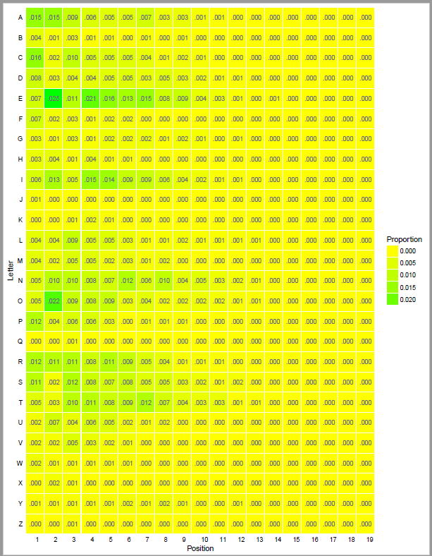
HEAT MAP OF WORD POSITIONS Exploratory analysis of the set of words

Slide 10
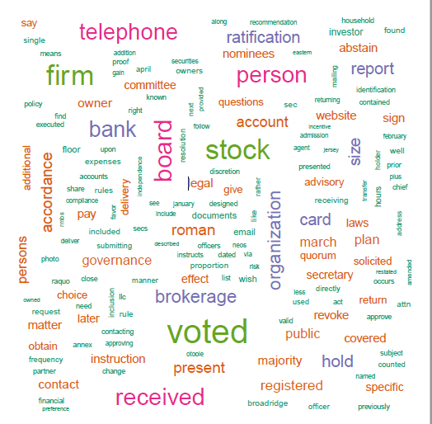
UNCLEANED WORD CLOUD

Slide 11
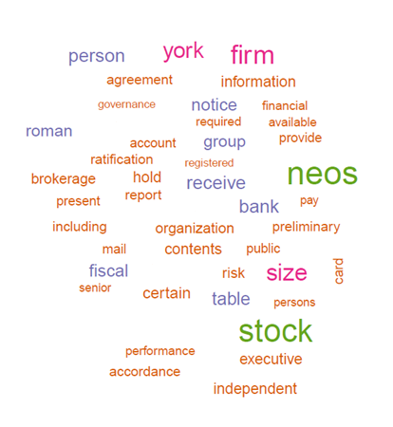
WORD CLOUD FOR 2016

Slide 12
Word Frequencies for KEI’s

Slide 13
KEI INDICATORS
The word “PUBLIC” repeated most number of times in the year 1999 was because the largest event in the firm’s history was the IPO in 1999. Only a small part of the company went public at this event which was 12%.
In the year 2012, the term “Stock” was repeated the most. There was a downfall in the stocks of the company and the main topic of discussion during the annual shareholders meeting was about this downfall of stocks.
In the year 2008 the most repeated word is “Mortgage”. During the year 2007-08 Goldman Sachs was able to earn profits during the Mortgage Crisis of summer 2007 by short-selling subprime bonds. Goldman Sachs made a profit of $4 Billion by betting on a collapse in the sub-prime market.
The word “ratification” was most frequented in the year 2015-16. This is because, the shareholders ratified the compensation of the present CEO Lloyd C Blank Fein by 66% vote.
The word “brokerage” will be found in all years. This entitles that Goldman Sachs is viewed as a brokerage firm too and hence it is not tightly coupled to the standards of transactions.
In 2016, we see the work of “NEO” very predominant. It is seen that in 2016, NEO “compensation” “received” the “support” of 66% of the “shareholders”.

